Slide 2
Mikael Nystrom Viktor Hedberg
Building a Resilient Hybrid IT-Infrastructure - Minimize the Impact of a Breach

Slide 3
Agenda
The Network
Securing the control plane
Virtualization
Manage Windows Server
Securing the backup

Slide 4
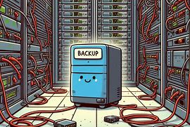
Isolate your backup
Management interfaces
Separate network
Separate DNS
Separate AD forest
Separate storage
Disconnected
Air-gapped
Escape room exercise

Slide 5
Restore and Recover is the first thing that needs to work, otherwise backup is useless
Time to restore
Storage Capacity
Protect the backup
Worst case scenario

Slide 6

Worst case scenario
All data needs to be restored
The existing infrastructure is encrypted
There are no documents that describe the process
There is nothing at all
And you need to have it up and running within 24 hours…

Slide 7

Time to restore
Where is the data?
How fast is the solution to GET the data
How fast is the solution to WRITE the data
If it takes 23 hours to backup the data, does it mean it takes 23 hours to restore it?

Slide 8

Capacity
You need to keep everything you have; they need to find Patient Zero
You suddenly need the same amount of that that you are currently using
You might need to get a new SAN
You might need to get a few servers, like 20-100
…before you can start restoring…

Slide 9

Protection
TA knows more about backup solutions than you do
Backtracking the trails of the backup solution
Making sure that whatever you had is wiped before launching the strike
Making sure they have all the nice things in the backup so that they can publish it globally

Slide 10
Protection
Isolated
Encrypted
One-way (Diode)
Separate authentication
Dedicated storage
Monitored
Offsite
Tape, yes, it is a great idea

Slide 11
Using Cloud backup in Azure
Microsoft Azure Backup Server
Microsoft Azure Recovery Services Agent

Slide 12
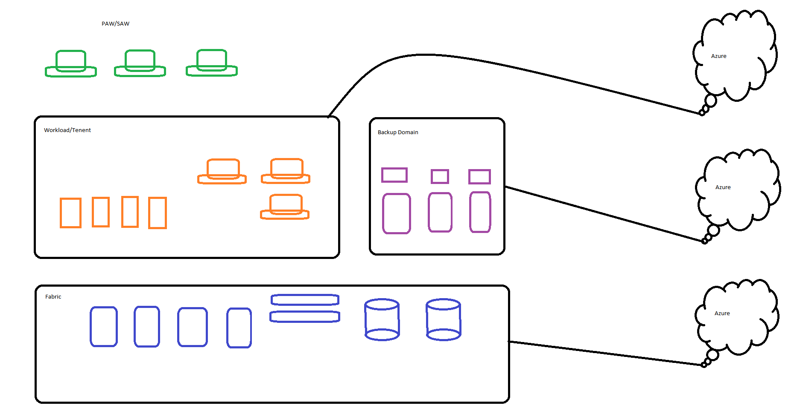

Slide 13
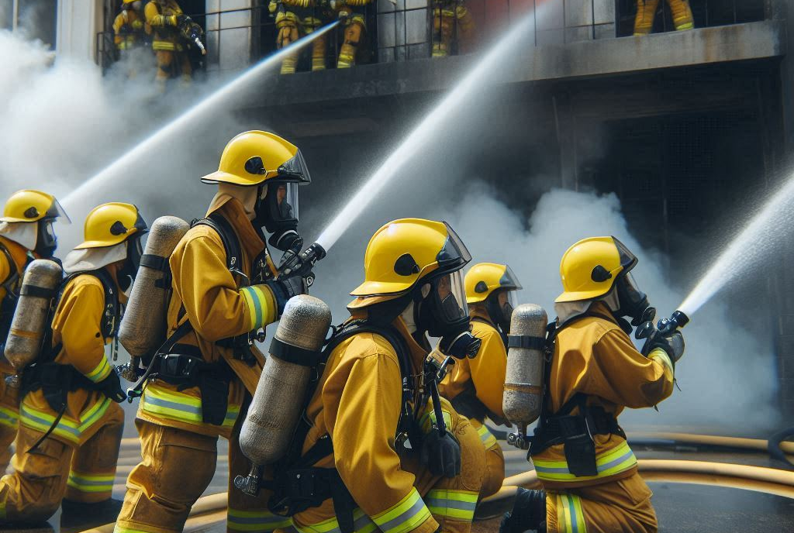
What about Disaster Recovery
Storage Replica
VM Replica
Cloud Replica
Failover Cluster

Slide 14
Thank you for listening!

